Slide 1
The SADC EPA – a view from South Africa
Trudi Hartzenberg
trudi@tralac.org
Les Accords de partenariat économique (APE) dans l’ocean Indien
Université de la Reunion
27-28 September 2018

Slide 2
Overview
Global trade governance - key developments
How does the SADC EPA fit into South Africa’s trade policy strategy?
Background to the trade relationship between the European Union and South Africa
The SADC Economic Partnership Agreement (institutions for implementation and improved market access)
Trade between SA and EU – what has happened since provisional application started?
Impact of Brexit on the SADC EPA, and trade between SA and EU and SA and UK

Slide 3
Global trade governance context
Impetus for global governance solutions –is weak (very different from the late 1980s, early 1990s, when WTO was established) - Crisis in the WTO? Who are the champions of the WTO? WTO and China?
Challenge to trade policy paradigm – concerns about distributional issues (who wins and who loses – search for inclusive approaches – eg gender, youth, social and environmental values)
United States trade policy – trade wars?
Brexit – undoing regional integration
What does this mean for Africa, and for Africa – EU trade relations? Appraising EPAs and incorporating new approaches (reviews, deepening agreements, reference to Africa – EU, US agreements?)

Slide 4
South Africa’s trade policy
Trade policy is used to support industrial development – strong focus on trade in goods and use of the import tariff to protect domestic industry (no strategy for trade in services yet)
In short: mercantilist trade policy (does not want an increase in import competition)
Trade partners:
Old friends - European Union, United States
Good friends – African countries
New friends – BRICS (China, India, Brazil, Russia)
Current priority: Africa (Southern African Customs Union, Southern African Development Community, Tripartite Free Trade Area negotiations, African Continental Free Trade Area negotiations)

Slide 5
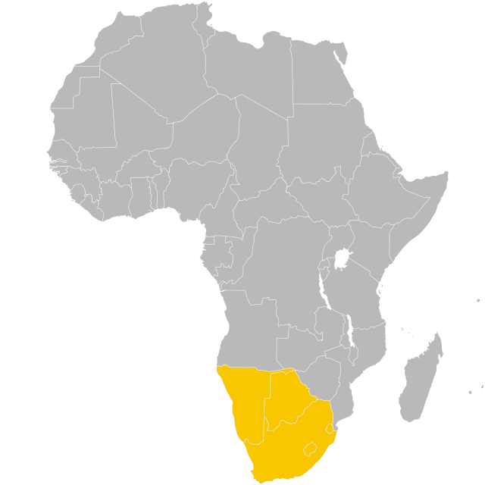
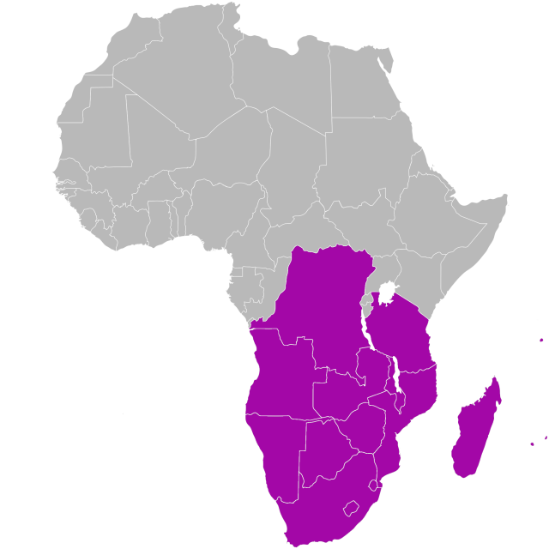
South Africa in Africa – participation in regional integration
SACU – 5 Member States
SADC - 16 Member States (13 in free trade area)

Slide 6
Tripartite Free Trade Area (TFTA)
TFTA was launched in June 2015, but negotiations are still ongoing
Tariffs (SACU – EAC; SACU – Egypt)
Rules of origin
Work programmes on:
Industrial development
Infrastructure
Trade facilitation
South Africa has started the process to ratify the Agreement

Slide 7
Continental Free Trade Area (CFTA)
55 Member States of the African Union
Key objective: boost intra-Africa trade
Focus: industrial development
Regional economic communities will continue to exist
Agenda - Phase1
- trade in goods (tariffs, NTBS…..customs...)
- trade in services
Agenda - Phase 2 (starting August 2019)
- intellectual property
- investment
- competition policy
Intra-Africa trade – low by global standards (17.6% for 2016); 50% takes place in SACU; 70% takes place in SADC

Slide 8
Economic Partnership Agreement (EPA) between SADC EPA Group and the European Union (EU)
EU (as a bloc) remains South Africa’s largest trading partner
After South Africa’s democratic transition (1994), admitted to the non-trade chapters of the Lomé Convention – and negotiations to conclude a bilateral trade agreement began
Trade Development and Cooperation Agreement (TDCA) between SA and EU entered into force on 1 January 2000 and was fully implemented in 2012
EPA negotiations with countries in SADC began in 2004 (SA was not included initially). SA requested to join EPA process - important given the regional integration arrangements (SACU) and to secure further market access especially in agriculture

Slide 9
SADC EPA concluded
South Africa joined the SADC EPA Group in 2007
The EPA was signed on 10 June 2016, between SADC EPA Group: South Africa Botswana, Lesotho, Namibia, Eswatini (Southern African Customs Union) and Mozambique - and the EU. Angola may accede to the agreement
Provisional application began on 10 October 2016 (Mozambique ratified in 2018), except for the new agriculture market access (entered into force on 1 November 2016)
EPA replaced the trade chapter of TDCA at entry into force
SADC EPA – a trade in goods agreement (South Africa was not interested to expand coverage to services and trade-related issues)

Slide 10
Tariff-related provisions
Duty free quota free access to EU markets for Botswana, Lesotho, Namibia, eSwatini and Mozambique (Art 24) – minor qualifications eg sugar (HS 1701)
SACU member states remove duties on 86% of goods; Mozambique on 74%
For SA: 98.7% of goods enter EU markets duty free
South Africa secured improved market access for 32 agricultural products (flowers, some dairy, fruit and nut products), significant improvement access to the EU market for wine (110 million litres duty free), sugar (150,000 tonnes duty free) and ethanol (80,000 tonnes duty free)
New market access for fishery products

Slide 11
Safeguard provisions to address import surges that may harm or or threaten to harm domestic industry
Safeguards under EPA
General bilateral safeguards
Spefic agricultural safeguards
Food security safeguards
BLNS transitional safeguards
Infant industry protection safeguards (not SA)

Slide 12
Rules of origin, export taxes and GIs
EPA rules of origin improve on the TDCA as they allow for extended cumulation that can facilitate intra-regional trade and industrialisation across the Southern and Eastern Africa in particular
Export taxes are permitted under certain circumstances
Protocol on Geographical Indications (GIs) protects 102 South African wines and three agricultural product names (Rooibos, honey bush and karoo lamb) – 250+ EU GIs are recognised by South Africa (some can be used, provided there is no consumer confusion). Provision to add 30 more GIs for South Africa

Slide 13
EPA Institutions for Implementation
Joint Council
Composed of the relevant members of the European Commission and SADC EPA Ministers
The Joint Council has powers to take decisions in respect of all matters covered by the agreement
Trade and Development Committee (TDC)
Assist the Joint Council in the performance of their duties
The TDC monitors and evaluates the implementation of the provisions of this Agreement.
The first Trade and Development Committee (TDC) meeting took place on 16 – 17 February 2017 in South Africa.

Slide 14
South Africa’s trade with the EU in 2017 (first full year under SADC EPA)
Over US$19.8 billion exported to the EU, in 2017 (about 30% of total exports)
Natural resource based primary products dominate although value added transport equipment, machinery also feature in exports, agricultural products also important (wine and fresh fruit).
Germany, UK, Netherlands and Belgium – top export destinations

Slide 15
Market Access under SADC EPA
New market access for South Africa into the EU:
The fish sector liberalized
South Africa now benefits from additional TRQs on selected tariff lines - wine, sugar, fruit juices, citrus jams, canned fruit, skimmed milk powder, butter, yeast and ethanol
List of TRQ products and respective quantities under TDCA and SADC EPA
PRODUCT | TDCA TRQ | SADC EPA TRQ
New TRQs
Cane/Refined Sugar | - | 50 000 tons
Sugar | - | 100 000 tons
Ethanol | - | 80 000 tons
Active Yeast | - | 350 tons
White crystalline powder | - | 500 tons
Citrus jams | - | 100 tons
Skimmed Milk Powder | - | 500 tons
Butter | - | 500 tons
Unchanged TRQs
Strawberry, frozen | 370 tons | 370 tons
Canned mixtures of tropical fruit | 2 960 tons | 2 960 tons
Expanded TRQs
Canned Mixtures of fruit, other than tropical fruit | 27 102 tons |  | 57 156 tons
Frozen orange juice | 1 036 tons |  | 3 602 tons
Wine | 50 126 000 litres |  | 110 000 000 litres
US$ 1.4 billion TRQ exports globally
(40% to EU)
Notes:
I

Slide 16
A closer look at new opportunities for South Africa

Slide 17
South Africa’s exports under TRQs (by value 2017)
Top EU export destinations include UK (31%), Germany (18%) Netherlands (15%) accounting for 64% export share
Wine accounts for 80%, sugar for 10% share (note that prior to SADC EPA – there were no significant exports of raw sugar)

Slide 18
South Africa’s TRQ utilisation
South Africa’s export of products with TRQs (2013 – 2017)
Product
 | Exports 2017 (tonnes except wine) | 2017 TRQ | Utilisation rate
Raw Sugar | 140 011 | 100 000 | 140%
Refined Sugar | 24 350 | 50 000 | 49%
Ethanol | 20 351 | 50 000 | 41%
Canned Mixtures of fruit, other than tropical fruit | 6 053 | 57 156 | 11%
Frozen orange juice | 2 798 | 3 602 | 78%
Canned mixtures of tropical fruit | 2 126 | 2 960 | 72%
Citrus fruit jams, | 757 | 100 | 757%
Active yeasts | 226 | 350 | 65%
White crystalline powder | 128 | 500 | 26%
Butter | 5 | 500 | 1%
Frozen Strawberries | 4 | 370 | 1%
Skimmed Powder Milk | 6 | 500 | 1%
Wine (qnty = million litres) | 216 | 110 | 196%
Save for wine, citrus jams and raw sugar, the rest of the TRQs are not being fully utilised e.g. ethanol, active yeasts and canned fruit

Slide 19
South Africa’s use of TRQs as at 18 Sept 2018
 | Quantity (tonnes)
Product | SADC EPA TRQ | 2018 (September) | Balance | % TRQ utilisation
Raw Sugar | 100 000 | 99 994 | 6 | 100%
Ethanol | 80 000 | 8 825 | 71 175 | 11%
Canned Mixtures of fruit, other than tropical fruit | 57 156 | 19 207 | 37 949 | 34%
Refined Sugar | 50 000 | 480 | 49 520 | 1%
Apple Juice | 3 712 | 3 066 | 646 | 83%
Canned mixtures of tropical fruit | 3 080 | 237 | 2 843 | 8%
Frozen orange juice | 1 078 | 1 078 | 0 | 100%
White crystalline powder | 500 |  | 500 | 0%
Butter | 500 |  | 500 | 0%
Skimmed Milk Powder | 500 |  | 500 | 0%
Frozen Strawberries | 393 |  | 393 | 0%
Active yeasts | 350 | 60 | 290 | 17%
Citrus fruit jams, | 100 |  | 100 | 0%
Bottled Wine (million litres) | 78 | 44 | 34 | 56%
Bulk Wine (million litres) | 34 | 34 | 0 | 100%

Slide 20
Brexit and the SADC EPA
UK Referendum: 23 June 2016
In March 2017, the UK Prime Minister gave notice under Article 50 of the Lisbon Treaty that the UK will be leaving the EU. This notification started the two year period of negotiations for the UK exit from the EU
Until the UK exits the EU, all the obligations of the EU, including under the EPA, will remain in place (note plans to avoid ‘cliff edge’)

Slide 21
Effect of BREXIT on EPA
Ongoing discussions between SA and the UK on the need to provide certainty to investors, producers and traders on the trade arrangement between SA (SACU) and UK post Brexit
Parties agree in principle that the best way to ensure a smooth transition and no interruption in the trade between the UK and SA will be to put an interim arrangement in place based on the EPA
SACU has been engaging with the UK (not negotiating) on an interim arrangement after Brexit (Roll over the terms of the SADC EPA)
Negotiating an FTA (if UK leaves the EU customs union) may take some years
There are a number of Tariff Rate Quotas (TRQs) in the EPA and SA will have to negotiate the volume of the TRQs with the UK

Slide 22
Brexit and the SADC EPA – trade facilitation matters
Practical trade facilitation matters
- trade routes – goods enter via eg Rotterdam and then to final destination
- rules of origin
- customs valuation etc documentation requirements
Time and Cost matters

Slide 23
How do exports reach EU markets?

Slide 24
Exports from SADC to UK

Slide 25
South Africa and BREXIT
South Africa’s exports of TRQ product to EU and UK’s relative importance (2017)
Description | 2017 (US$ 000) |  | UK %share - EU total
 | EU total | UK
Total | 486 420 | 153 617 | 32%
Wine | 387 833 | 118 571 | 31%
Canned Mixtures of fruit, other than tropical fruit | 18 653 | 16 957 | 91%
Raw Sugar | 47 219 | 12 691 | 27%
Refined Sugar | 11 428 | 3 871 | 34%
Canned mixtures of tropical fruit | 3 546 | 834 | 24%
Frozen orange juice | 4 268 | 633 | 15%
Butter | 38 | 31 | 82%
Active yeasts | 740 | 20 | 3%
Skimmed Powdered Milk | 14 | 6 | 43%
White crystalline powder | 51 | 2 | 4%
Frozen Strawberries | 7 | 1 | 14%
Citrus fruit jams, | 1 463 | 0 | 0%
Ethanol | 11 174 | 0 | 0%
UK is an important market for South Africa’s products which get TRQ preferential access to the EU and any disruption of trade such as the uncertainty around post-BREXIT trade arrangements may severely affect South Africa’s exports

Slide 26
Wine exports to the EU and the UK
 |  | 2017 (million litres)
HS code | Description | EU | UK | UK % share of EU
 | Total | 216 | 71 | 33%
'220429 | Bulk wine | 122 | 47 | 38%
'220421 | Bottled wine | 65 | 22 | 33%
'220422 | Bag in Box | 27 | 3 | 10%
'220410 | Sparkling wine of fresh grapes | 1 | 1 | 51%

Slide 27
Brexit Options (Source BBC)
Some other countries already have their own arrangements and these could give an idea of what is to come for the UK.
Alternative Brexit models
 | EU membership | Norway | Switzerland | Canada | Turkey | WTO
Single market member? | Full | Full | Partial | No | No | No
Tariffs? | None | None (except farm products and fish) | None | Reduced tariffs through free trade deal | None on industrial goods | Yes
Accept free movement? | Yes | Yes | Yes | No | No | No
In the customs union | Yes | No | No | No | Yes | No
Makes EU budget contributions | Yes | Yes | Yes (but smaller than Norway) | No | No | No

Slide 28
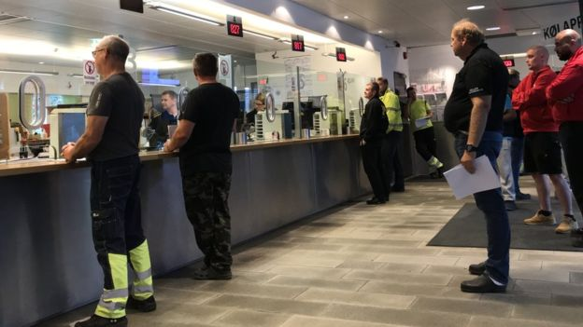
Truck drivers at the Sweden - Norway border: reminder that a border is a border
Source: BBC

Slide 29
Conclusions
South Africa’s trade relationship with the EU is very important
Some opportunities in the SADC EPA are not used - demonstrates challenges associated with effective implementation (eg meeting sanitary and phyto sanitary standards – this impacts not only trade with EU, but with other partners too)
Brexit may require that some renegotiation of provisions eg on TRQs in the SADC EPA is necessary
NOTE: Africa is increasingly a priority – politically, as well as a set of export markets (agriculture – eg apples, citrus; manufactures) - SA is competitive in Africa in manufactures - this is supported by SA’s services suppliers in Africa (logistics, financial services, transport, communication, wholesale, retail)

