Slide 1
Economic Partnership Agreement in ESA region, state of play and the future
Anna Brzozowska
Trade Counsellor, European Union Delegation to the Republic of Mauritius and Seychelles

Slide 2
Content
1. Trade Policy and EPA's place within it
2. Negotiations agenda with Africa
3. EPAs do work: impact on businesses and employment
4. Support for EPAs and ESA EPA Deepening process

Slide 3

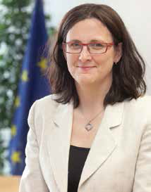
Trade for All-towards a responsible trade and investment policy
Communication of October 2015
http://trade.ec.europa.eu/doclib/docs/2015/october/tradoc_153846.pdf
Trade Commissioner
Cecilia Malmström

Slide 4
The core of the EU policy
Trade is for all & trade and investment policy are conducted in an ever more responsible way.
Benefits of trade should be accessible to
Consumers, workers, self-employed and citizens at large, small, medium and large enterprises
As well as all people in partner countries, in particular the poorest in the developing world.
Effective, transparent and based on EU values

Slide 5
Responsible means...
Effective:
Take account of new economic realities:
  Integrated global value chains – importance of imports – international regulatory co-operation – digital economy – energy and raw materials – intellectual property rights protection – customs facilitation – etc.
Ensure coherence and mutual supportiveness between trade and related policies, particularly development co-operation:
  Inclusive and sustainable growth in developing countries, regional integration, creation of decent jobs, etc.

Slide 6
Responsible also means...
Based on values:
Expand action to support sustainable development, inclusive growth, creation of decent jobs, fair & ethical trade, responsible supply chains, human rights
Safeguard and promote the EU regulatory protection
Lead a reform of investment policy globally (from investor-to-state dispute settlement to an Investment Court System)
Establish anti-corruption provisions in future FTAs

Slide 7
The EPA vision
  to support Africa's trade and development with asymmetric commitments
  partnership with rights and obligations for both sides, particularly on sustainable development, which is an explicit EPA objective
  objective of true African regional integration and African integration into the world economy
  EPAs are more than unilateral tariff preferences like AGOA

Slide 8
Negotiation agenda with Africa
Redefine the relationship with Africa:
  Effective implementation of existing EPAs, deepening for ESA EPA
  Conclude the process leading to the entry into application of pending EPAs
  Deeper relations bilaterally with African countries without an EPA and with the African Union (strategic partnership)
  The EU sees EPAs as building blocks for regional integration eventually leading to integration at continental level

Slide 9
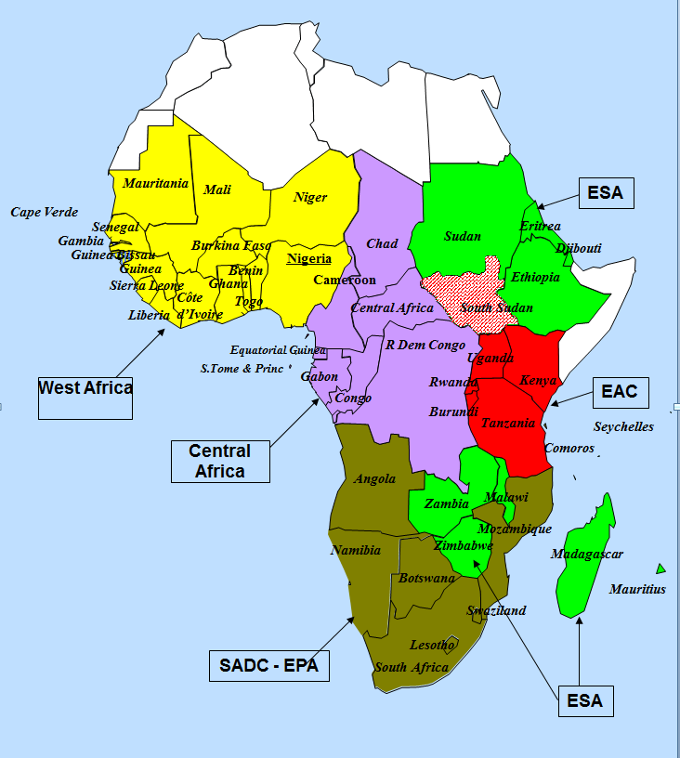
The five African EPA groups
Notes:
Negotiation of an EU-COMESA FTA failed because the African partners could not agree and preferred to strengthen existing customs unions (SECU and EAC).

Slide 10
EPAs work:
Total trade of EPA 4 increased by 24% since , application, exports even faster + 25,3 %
Exports to EU – positive balance for ESA 4, the EU has minus € 501 million balance (2017)
Jobs in exports oriented sectors
Closer links between partners in the region – transfer of experiences
Value addition
Giving voice to private business forums

Slide 11
EPAs work:

Slide 12

EPAs do work: Mauritius
'''The EPA enables Mauritius
to develop quite advanced
sectors requiring extensive
transformation as well as
an important work force:
this is the principle of these
agreements.’
ERIC MAMET
Managing Director, Creasim Ltée

Slide 13
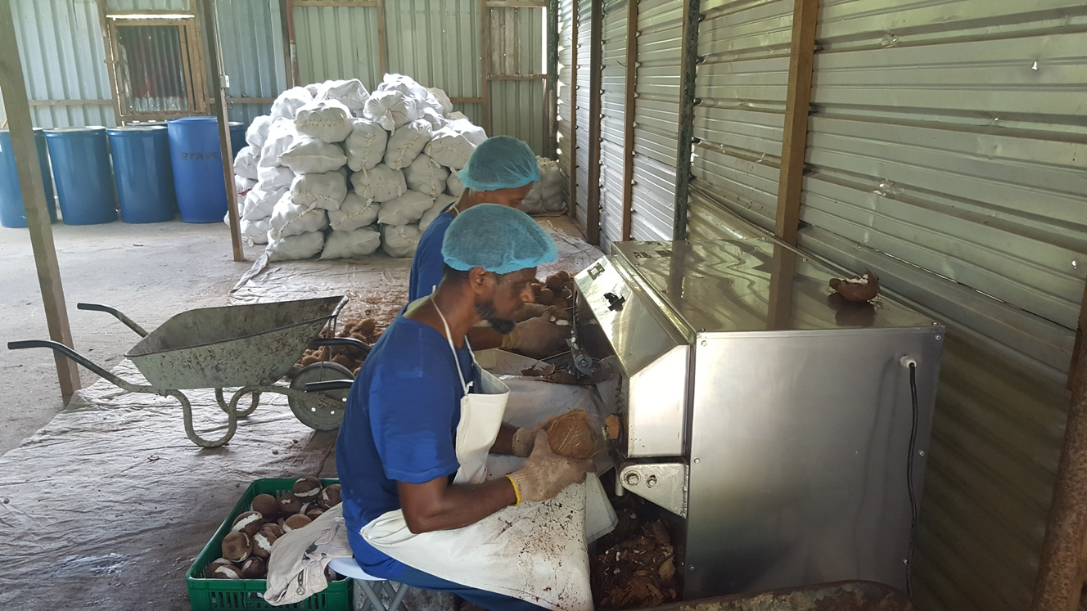
EPAs do work: Seychelles
I was among the team who negotiated the Economic Partnership Agreement and without doubt it is a very important facility given to us in the export sector allowing our products to enter the European market quotas and tariffs free. Seychelles despite being a high income country still needs the EPA and at the same time identify new export opportunities to truly benefit from it’
Mustafa BRISTOL, GLOBAROM

Slide 14
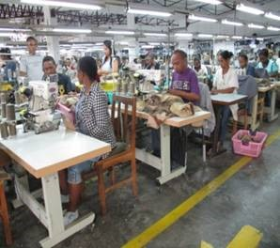
EPAs do work: Madagascar
Macotex, Tecma: specialises in high level safety/special clothing, uniforms; produce 100% for exports.
Out of 850 employees, 90% are women
CSR: medical care, trainings, plans to create a textile college

Slide 15
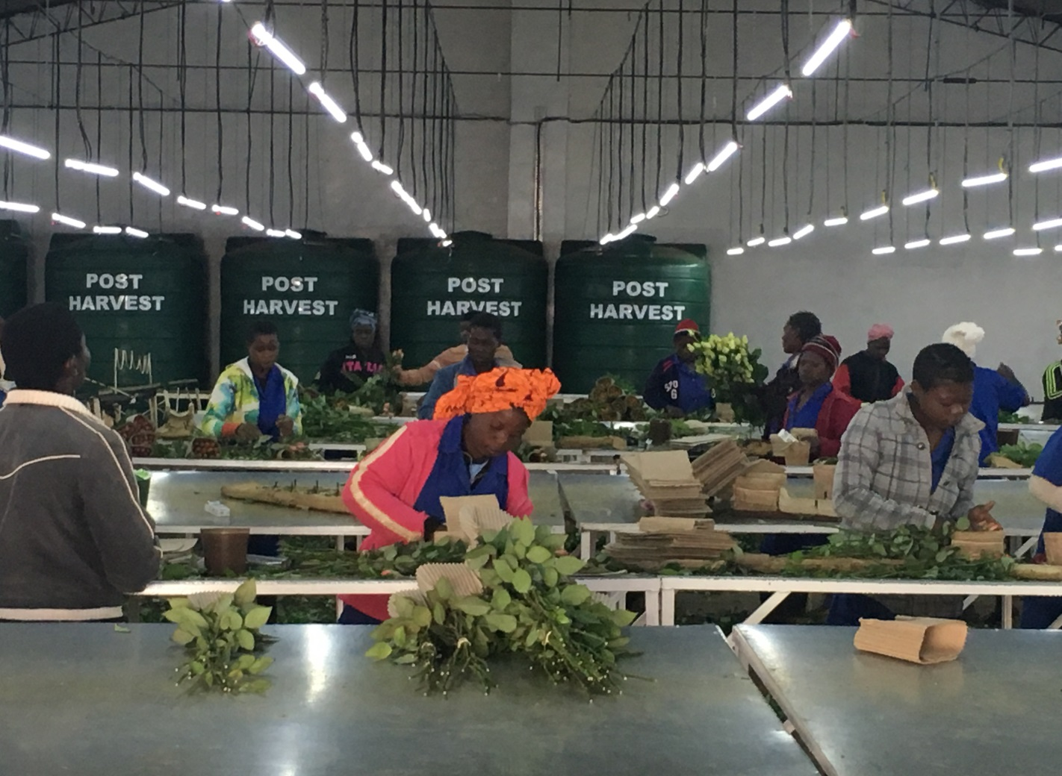
EPAs work: Zimbabwe
Luxaflor - 350 employees. 55% of staff are female and 45% male.
Exports to South Africa and Europe
Cut flower export has huge potential in ZIM

Slide 16
EPAs - supported through financial and non-financial means
National EPA Implementation Plans –
Funds earmarked under NIPs/RIPs
(including €10 million per ESA EPA country)
External Investment Plan
- Trade-related or other suitable policy dialogues – e.g. Gender and Climate dialogue in Mauritius

Slide 17
ESA EPA deepening
Scoping paper (1st draft - the end of September)
Joint meeting planned for the 3rd week of November in Bruxelles
Issues: Services, Investment, SPS, TBTs; Rules of Origin, Intellectual Property Rights, Agriculture; Competition; Public Procurement, Dispute Settlement
Institutional Structure
Trade and Sustainable Development
Coordination Hub

Slide 18
Thank you and please note the address of our TRADE Helpdesk http://trade.ec.europa.eu/tradehelp/

