Slide 1

Preferential Trade Agreements in the era of SDGs
Jaime de Melo
FERDI and Université de Genève
Conference: The Economic Partnership Agreemens (EPAs) in the Indian Ocean, Faculté de Droit et de Sciences Economiques de l Réunion, 27-28 Septembre 2018

Slide 2
OUTLINE
Evaluation of EPAs (summary)
A Primer on African RTAs
Sustainability Provisions in PTAs
Environmental Provisions in African PTAs
Coverage of Provisions and enforceabilityEU-US PTAs
Elusive Doha (2001)-EGA (2014-?)
Negotiations: submissions of EG Lists
Mercantilism at work
Conclusion: Why non-participation by developing countries
Evidence on Trade in Egs
Outcome based (GHG emisions)
Bilateral Trade in Egs (more intense with lower tariffs and with convergence in regulatory measures)

Slide 3
Evaluation of EPAs
Journal of African Trade, vol.1(1)
Policy brief associated with paper https://www.theigc.org/wp-content/uploads/2015/03/De-Melo-Regolo-2014-Policy-Brief.pdf
Blog-post appraisal of other African RTAs https://www.theigc.org/blog/regional-trade-agreements-in-africa-success-or-failure/

Slide 4
“A Primer” on African
Regional Economic
Communities (RECs)

Slide 5
A Primer on African RTAs
AfcFTA will call for a harmonization of Rules of origin. A headache down the road

Slide 6
RECs have not been followed by increased intra-REC trade
but ASEAN was followed by increased intra-regional trade but not MERCOSUR, ANDEAN

Slide 7
Regime-wide Rules of Origin
(Product-specific not covered here)

Slide 8
Preference margins and PURs
(Preference Utilization rates)

Slide 9
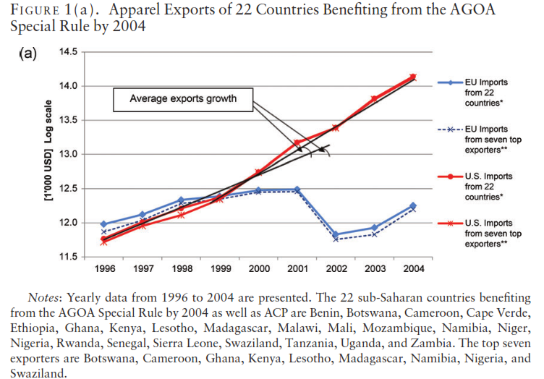
Moving to the single transformation rule: AGOA vs EBA

Slide 10
DEPTH of RTAs
7 RECs vs 108 S-S FTAs
Coverage of WTO+ measures
Coverage of WTO-X
Measures (those that go beyond WTO agenda)

Slide 11
FTAs in the era SDGs

Slide 12
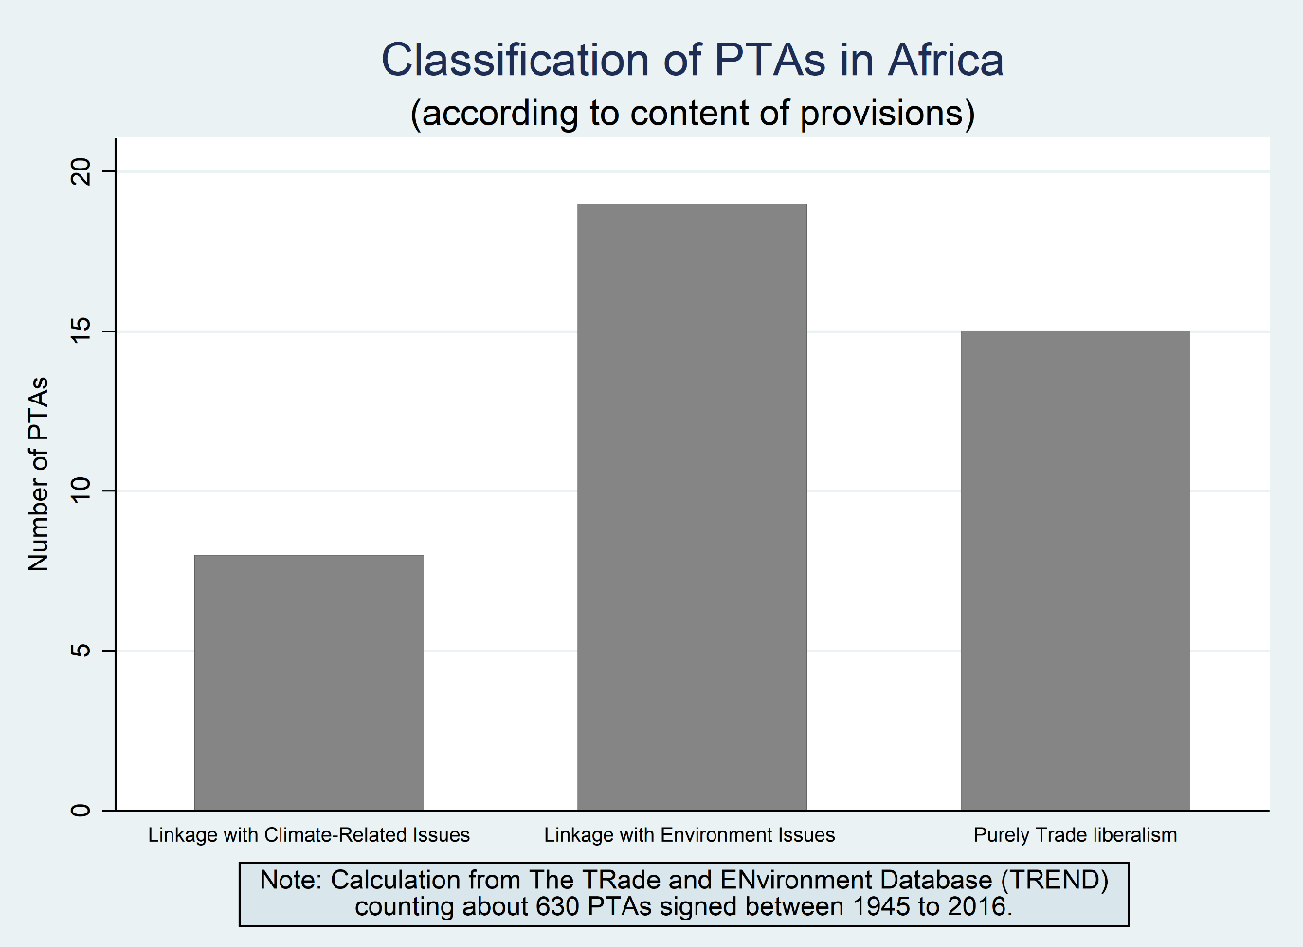
Environmental Provisions across 34 African RTAs
Melo and Sorgho (2018)

Slide 13
Environment-Issues Contained in African RTAs
Agreement | Does It Contain Environmental Provisions? | Provision related to Issue-areas protection
 |  | Climate Change | Biodiversity | Water | Waste | Fishery | Forest | Desert | Air & Ozone
COMESA | (Yes) | Yes | Yes | Yes | Yes | Yes | Yes | Yes | Yes
AMU | (No) | No | No | No | No | No | No | No | No
CEMAC | (No) | No | No | No | No | No | No | No | No
ECCAS | (Yes) | Yes | No | No | No | No | No | No | No
ECOWAS | (Yes) | Yes | Yes | No | Yes | Yes | No | Yes | No
EAC | (Yes) | Yes | Yes | No | Yes | Yes | No | No | No
SADC | (Yes) | No | No | No | No | No | No | No | No
UEMOA | (Yes) | No | No | No | No | No | No | No | No

Slide 14
Coverage of Sustainability Provisions in PTAs
A dot indicates that at least one reference is made in at least one agreement of that country
Source: Baker (2018)

Slide 15
Enforceability of Sustainability Provisions in EU and US PTAs
Source: Baker (2018)

Slide 16
Elusive Doha (2001)-EGA (2014-?)
The expected Triple win
Trade: Decrease cost of environmental technologies, stimulate innovation and transfer of technologies; protect resources
Developing countries:Access to HIC markets for Asian economies + higher-quality EGs on world markets for all developing countries ⇒ Emissions ↓; Environment preserved for all
Our planet: At global level environment better preserved especially if wide definition of EGs
The reality of the negotiations: Mercantilism at work !!!
∎Reduction/elimination of barriers to trade in EGs But how defined (...by negotiators)? Project, request/offer, list (HS6)
⇒18 years of wrangling at Doha/EGA ⇒ Only tariffs on agenda
∎ NTBs left off agenda
∎Env. Services (ESs) not on agenda (though strong complementarity with EGs)
⇒ A minima agenda at Doha, APEC, and EGA negotiations (2014)

Slide 17
Applied Tariffs by lists and country groups
(<10% except LIC)
Patterns
Tariffs on EGs lower than non-EGs for all lists
Very little on the table for HICs
Tariffs increase for all lists HICs⇾ LICs
Only LIC group expected to have non-negligible increase in Trade flows
Only HICs have reduced applied tariffs on EGs via RTAs
APEC (54): primarily GEM (end-of-pipe)
EPP(104):Environmentally Preferable Products
WTO (411): Compendium of all HS6 products submitted by countries participating

Slide 18
Exports by EG list (APEC and EPP)
Patterns
•HICs chose EGs they exported
• Developing countries would do better on EPP list
• …but still less with only between 20% and 40% of goods on EPP list that are exported.

Slide 19
Mercantilism at work (1)
• For APEC list, probability of RCA>1 larger for goods on list, but only for HICs

Slide 20
Mercantilism at work (2)
• Insignificant tariff peaks on both lists
• ...but lower on EPP list (difference reflecting APEC list concentrates on intermediate goods)
• Conclusion: Not much on the negotiating table

Slide 21
Conclusion: Why non-participation by developing countries.
1. Lists drawn by HICs/UMICs (APEC(54)/CLEG(248)/ WTO(411). The lists reflect comparative advantage of HICs. Lists systematically exclude goods with tariff peaks (confirms with mercantilistic behavior by negotiators).
1. Fear by developing countries of large responses on import side but low on export side. (high tariffs and low RCA)
2. Grow up first, clean up later’ (get a larger home market after environmental regulations create a market for EGs with lower price level because of expanded bundle of goods (‘love of variety’ mechanims)
3. Stay on sidelines: small stakes (low tariffs of HICs ⇨ little market access) + avoid dealing with ‘like products’ and PPMs at WTO

Slide 22
Evidence From Gravity models (1)
Strict environmental policies associated with RCA in EGs.
Identification via policy changes (e.g. KP). Environmental policies affect trade flows. Aichele and Felbelmayer (2015)
Identification by gravity models: RTAs with environmental provisions have better outcomes on emissions (Bhagdadi et al.)
Emissions gap for GHGs emissions per capita are smaller for countries that engage in bilateral trade in Egs (Tamini and Sorhgo (2017).

Slide 23
(New)Evidence from Gravity Models (2)

Slide 24
Evidence on Environmental Policies (3)

Slide 25
Evidence From Gravity Model (3)

Slide 26
Conclusions
• Superior environmental outcomes in terms of GHG emissions per capita for countries that trade in Egs
• MRAs and regulatory convergence helpful to boost trade in EGs
A successful EGA could deliver a triple win
• Wrangling over negotiations for nearly 20 years
• Unfortunately agenda lacks ambition
• but success is still a key ingredient for transition to green development path
• …and to prevent collision of WTS and climate regime

Slide 27
References (1)
Baghdadi L., Martinez-Zarzoso I., and Zitouna H., (2013), ’Are RTA agreements with environmental provisions reducing emissions?’, Journal of International Economics 90:378–390.
Baker, P. (2018) “Handbook on Negotiating Sustainable Development Provisions in PTAs” https://artnet.unescap.org/publications/books-reports/handbook-negotiating-sustainable-development-provisions-preferential
Helbe, M. and B. Shepherd eds. (2017) “Win-Win: How International Trade can help meet the sustainable development goals,” ADB, https://www.adb.org/sites/default/files/publication/327451/adbi-win-win-how-international-trade-can-help-meet-sdgs.pdf

Slide 28
References (2)
Melo, J. de and J.M Solleder (2018) “Barriers to Trade in Environmental Goods: How Important they are and what should developing countries expect from their removal” FERDI WP#233
Melo and Sorgho (2018) “The Landscape of Environmental Provisions in African RTAs” (in progress?)
Tamini L. D., and Sorgho Z., 2017. ‘Trade in Environmental Goods: Evidences from an Analysis Using Elasticities of Trade Costs’, Environment and Resource Economics.

